Slide 1

Blessed Be Your Name

Slide 2
CAPO 2nd
G D Em7 C
Blessed be Your name in the land that is plentiful
G D C
Where Your streams of abundance flow, blessed be Your name
G D Em7 C
Blessed be Your name when I'm found in the desert place
G D C
Though I walk through the wilderness, blessed be Your name

Slide 3
G D Em7 C
Every blessing You pour out I'll turn back to praise
G D Em7 C
When the darkness closes in Lord, still I will say
G D
Blessed be the name of the Lord
Em7 C
Blessed be Your name
G D
Blessed be the name of the Lord
Em7 D C
Blessed be Your glorious name

Slide 4
G D Em7 C
Blessed be Your name when the sun's shining down on me
G D C
When the world's all as it should be, blessed be Your name
G D Em7 C
Blessed be Your name on the road marked with suffering
G D C
Though there's pain in the offering, blessed be Your name

Slide 5
G D Em7 C
Every blessing You pour out I'll turn back to praise
G D Em7 C
When the darkness closes in Lord, still I will say

Slide 6
G D
Blessed be the name of the Lord
Em7 C
Blessed be Your name
G D
Blessed be the name of the Lord
Em7 D C
Blessed be Your glorious name
x2

Slide 7
G D Em7 C
You give and take away, You give and take away
G D Em7 C
My heart will choose to say, "Lord, blessed be Your name"
x2

Slide 8
G D
Blessed be the name of the Lord
Em7 C
Blessed be Your name
G D
Blessed be the name of the Lord
Em7 D C
Blessed be Your glorious name
X2 END

Slide 9

Eagles Wings

Slide 10
Am / D / G / C
Am / D / G / C
Am D G C
Here I am waiting Abide in me I pray
Am D G
Here I am longing for You
Am D G C
Hide me in Your love, Bring me to my knees
Am D G C D
May I know Jesus more and more

Slide 11
G C
Come live in me
Am D
All my life, take over
G C
Come breathe in me
Am D G
And I will rise on Eagles Wings

Slide 12
Am D G C
Here I am waiting, abide in me I pray
Am D G
Here I am longing for You
Am D G C
Hide me in Your love, bring me to my knees
Am D G C D
May I know Jesus more and more

Slide 13
G C
Come live in me
Am D
All my life, take over
G C
Come breathe in me
Am D G
And I will rise on Eagles Wings
x2 END

Slide 14
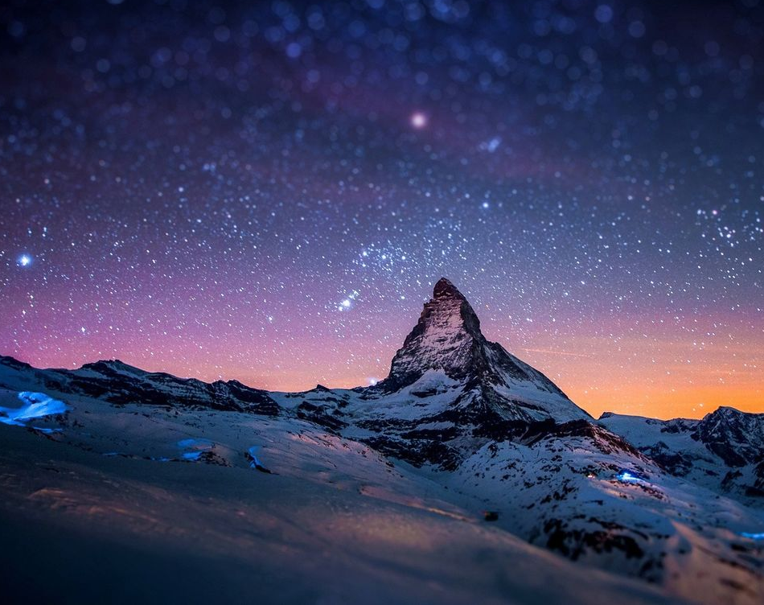
It Is Well

Slide 15
CAPO 3rd
G C D G
When peace like a river attendeth my way
Em A D
When sorrows like sea billows roll
G C A D
Whatever my lot, Thou hast taught me to say
G C D G
It is well, it is well with my soul

Slide 16
G D
It is well (it is well)
D G
With my soul (with my soul)
C G D G
It is well, it is well with my soul

Slide 17
G C D G
Though Satan should buffet, though trials should come
Em A D
Let this blest assurance control
G C A D
That Christ has regarded my helpless estate
G C D G
And has shed His own blood for my soul

Slide 18
G D
It is well (it is well)
D G
With my soul (with my soul)
C G D G
It is well, it is well with my soul

Slide 19
G C D G
My sin - O, the bliss of this glorious thought
Em A D
My sin - not in part but the whole
G C A D
Is nailed to the cross and I bear it no more
G C D G
Praise the Lord, praise the Lord, O my soul

Slide 20
G D
It is well (it is well)
D G
With my soul (with my soul)
C G D G
It is well, it is well with my soul

Slide 21
G C D G
And, Lord haste the day when the faith shall be sight
Em A D
The clouds be rolled back as a scroll
G C A D
The trump shall resound and the Lord shall descend
G C D G
Even so - it is well with my soul

Slide 22
G D
It is well (it is well)
D G
With my soul (with my soul)
C G D G
It is well, it is well with my soul

Slide 23
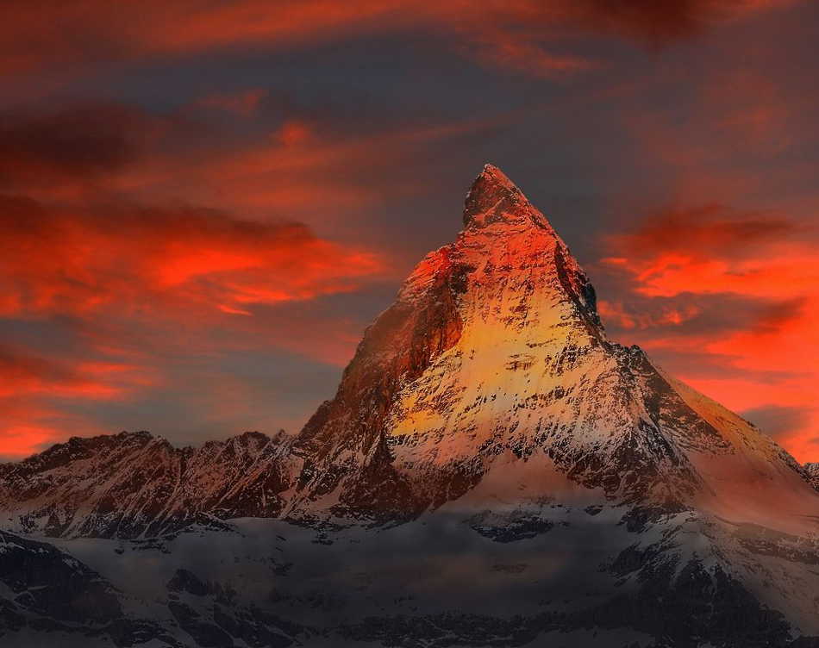
Hymn of Heaven

Slide 24
C Csus C
How I long to breathe the air of Heaven
Am F G
Where pain is gone and mercy fills the streets
C F C G Am
To look upon the one who bled to save me
F G C Csus C
And walk with Him for all eternity

Slide 25
C F G C
Oh, There will be a day When all will bow before Him
C F Am G
There will be a day When death will be no more
C F G C G Am
Standing face to face With He who died and rose again
F G C
Holy holy is the Lord

Slide 26
C F C
Every prayer we prayed in desperation
Am F G
The songs of faith we sang through doubt and fear
C F C G Am
In the end we’ll see that it was worth it
F G C Csus C
When He returns to wipe away our tears

Slide 27
C F G C
Oh, There will be a day When all will bow before Him
C F Am G
There will be a day When death will be no more
C F G C G Am
Standing face to face With He who died and rose again
F G C
Holy holy is the Lord

Slide 28
C F C
On that day we join the resurrection
Am F G
And stand beside the heroes of the faith
C F C G Am
With one voice a thousand generations
F G C
Sing “worthy is the Lamb who was slain”

Slide 29
C F C
On that day we join the resurrection
Am F G
And stand beside the heroes of the faith
C F C G Am
With one voice a thousand generations
F G C
Sing “worthy is the Lamb who was slain”
F G C Csus C
“Forever He shall reign”

Slide 30
C F G C
So let it be today we shout the hymn of Heaven
C F Am G
With angels and the Saints we raise a mighty roar
C F G C G Am
“Glory to our God” who gave us life beyond the grave
F G C
Holy holy is the Lord

Slide 31
C F G C
So let it be today we shout the hymn of Heaven
C F Am G
With angels and the Saints we raise a mighty roar
C F G C G Am
“Glory to our God” who gave us life beyond the grave
F G Am
Holy holy is the Lord
F G Am
Holy holy is the Lord
F G C Csus C
Holy holy is the Lord
END

Slide 32
Amazing Grace

Slide 33
G C G
Amazing Grace how sweet the sound
G D
That saved a wretch like me
G C G
I once was lost but now am found
G D G
Was blind but now I see

Slide 34
G C G
T'was Grace that taught My heart to fear
G D
And Grace, my fears relieved
G C G
How precious did that Grace appear
G D G
The hour I first believed

Slide 35
G C G
Through many dangers Toils and snares
G D
I have already come
G C G
’Tis grace hath brought me safe thus far
G D G
And grace will lead me home

Slide 36
G C G
The Lord has promised good to me
G D
His Word my hope secures
G C G
He will my Shield and Portion be
G D G
As long as life endures
END

